Slide 1
Unit 4: Cryptocurrencies

Slide 3

Managing entity: Ethereum Foundation
Major players: Deloitte, Toyota, Microsoft, …
Focus: Open-source, flexible, platform
Cryptocurrency: 1 Ether = 1e18 Wei (502 USD, 2018/04)
Smart contracts: Solidity, Remix (Web IDE), Truffle (Dev./Test), Viper
Ethereum Virtual Machine (EVM)
Permisionless (public) ledger: Proof-of-Work, Proof-of-Stake (Casper)
Notes
GHOST Protocol: Merging of branches
DOA Event: $150 million lost, hard forked into Eth. Classic
Scalability: Sharding and Plasma
3.1 ETHEREUM

Slide 4
Evolution in business logic
Proliferation of Bitcoin spawn-offs
Digital currency is not the only electronic object of value
Documents: authorizations, legal, diploma, design, various deliverables
Software
Support for extended financial applications such as crowdfunding
Support for multi-party escrow transactions
Ethereum envisioned that a single platform supporting the above is better than hundreds of specialized systems
Provided a verifiable Turing-complete script language
With script templates
Scripts can be stateful, with a state stored on the chain
3.1 ETHEREUM

Slide 5
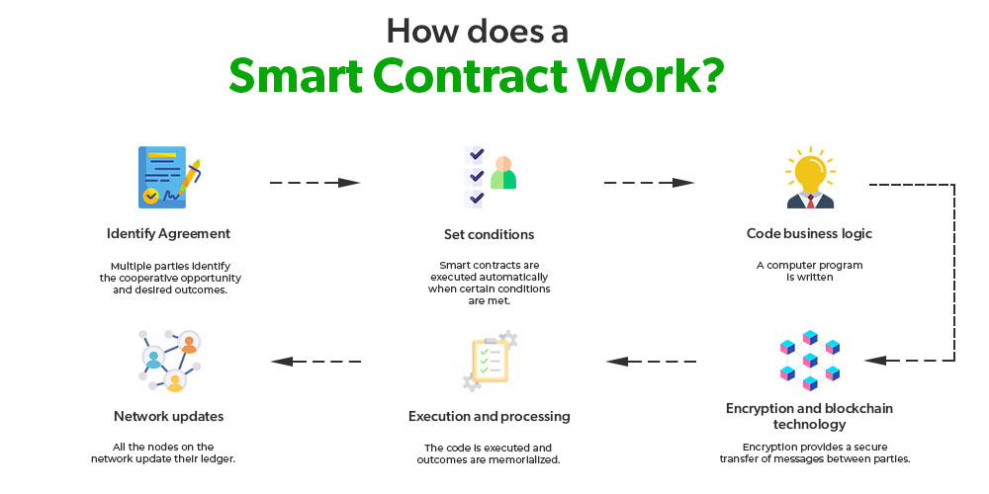
A Smart Contract is a computer program that directly and automatically controls the transfer of digital assets between the parties under certain conditions.
A smart contract works in the same way as a traditional contract while also automatically enforcing the contract.

Slide 6
Features of Smart Contracts
Distributed: Everyone on the network is guaranteed to have a copy of all the conditions of the smart contract and they cannot be changed by one of the parties. A smart contract is replicated and distributed by all the nodes connected to the network.
Deterministic: Smart contracts can only perform functions for which they are designed only when the required conditions are met. The final outcome will not vary, no matter who executes the smart contract.
Immutable: Once deployed smart contract cannot be changed, it can only be removed as long as the functionality is implemented previously.
Autonomy: There is no third party involved. The contract is made by you and shared between the parties. No intermediaries are involved which minimizes bullying and grants full authority to the dealing parties. Also, the smart contract is maintained and executed by all the nodes on the network, thus removing all the controlling power from any one party’s hand.
Customizable: Smart contracts have the ability for modification or we can say customization before being launched to do what the user wants it to do.
Transparent: Smart contracts are always stored on a public distributed ledger called blockchain due to which the code is visible to everyone, whether or not they are participants in the smart contract.
Trustless: These are not required by third parties to verify the integrity of the process or to check whether the required conditions are met.
Self-verifying: These are self-verifying due to automated possibilities.
Self-enforcing: These are self-enforcing when the conditions and rules are met at all stages.

Slide 7
Capabilities of Smart Contracts
Accuracy: Smart contracts are accurate to the limit a programmer has accurately coded them for execution.
Automation: Smart contracts can automate the tasks/ processes that are done manually.
Speed: Because everything is coded, the time taken to do all the work is the time taken for the code in the smart contract to execute.
Backup: Every node in the blockchain maintains the shared ledger, providing probably the best backup facility.
Security: Cryptography can make sure that the assets are safe and sound. Even if someone breaks the encryption, the hacker will have to modify all the blocks that come after the block which has been modifiedSavings: Smart contracts save money as they eliminate the presence of intermediaries in the process. Also, the money spent on the paperwork is minimal to zero.
Manages information: Smart contract manages users’ agreement, and stores information about an application like domain registration, membership records, etc.
Multi-signature accounts: Smart contracts support multi-signature accounts to distribute funds as soon as all the parties involved confirm the agreement.

Slide 8
The idea behind smart contracts is pretty simple. They are executed on a basis of simple logic, IF-THEN for example:
IF you send object A, THEN the sum (of money, in cryptocurrency) will be transferred to you.
IF you transfer a certain amount of digital assets (cryptocurrency, for example, ether, bitcoin), THEN the A object will be transferred to you.
IF I finish the work, THEN the digital assets mentioned in the contract will be transferred to me.

Slide 9
Benefits of smart contracts
Compared to a human intermediary
Cheaper
Open and transparent program that fulfils the contract
and does nothing else
Does not peek into your data
Highly resistance to attacks
Compared to distributed databases
Rule-based rather than data-based
Rich language and (relative) easy of development
The collection of rules is transparent and reusable
May initiate and play an active role in the communication
May integrate and fuse data from multiple sources
3.1 ETHEREUM

Slide 10






Smart Contracts
Block 3
Block 4
Proof-of-Work: 00000090b41bx
Proof-of-Work:
000000r9d8fjj
Previous POW:
000000948fixf
Contract 102890h
Previous block: 00000090b41bx
Transaction D
Chainstate
Database
Transaction 1236foer
Transaction N
Transaction 4364rote
Transaction C
nonce 87874951
nonce 79146512
3.1 ETHEREUM
52

Slide 11
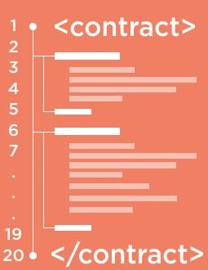
Smart Contracts
Contracts contain executable bytecode
Created with a blockchain tx
Contracts have internal storage
Block 3
Block 4
Proof-of-Work: 00000090b41bx
Proof-of-Work:
000000r9d8fjj
Previous POW:
000000948fixf
Contract 102890h
Previous block: 00000090b41bx
Transaction D
Chainstate
Database
Transaction 1236foer
Transaction N
Transaction 4364rote
Transaction C
nonce 87874951
nonce 79146512
3.1 ETHEREUM
52

Slide 12
Smart Contracts
Contracts contain executable bytecode
Created with a blockchain tx
Contracts have internal storage
Wallet ID | Held Titles
99823428347 | 34356,324324
98217981623 | 677343,4444
90987344755 | 994,38842,439
Contracts execute when triggered by a transaction (or by another contract) Execution time is limited by gas Example: Land registry
Block 3
Block 4
Proof-of-Work: 00000090b41bx
Proof-of-Work:
000000r9d8fjj
Previous POW:
000000948fixf
Contract 102890h
Previous block: 00000090b41bx
Transaction D
Chainstate
Database
Transaction 1236foer
Transaction N
Transaction 4364rote
Transaction C
nonce 87874951
nonce 79146512
3.1 ETHEREUM
52

Slide 13

Account State (“World State”)
Wallet ID | Balance | Code Hash | Internal State
99823428347 | 45.12 | - | 99554HGJ
98217981623 | 1123.332 | 9ERU12T4 | 3453ADFG
90987344755 | 9.3444 | 0490CNDJ | 132GJR4
Chainstate Database
3.1 ETHEREUM
53

Slide 14
Account State (“World State”)
Wallet ID | Balance | Code Hash | Internal State
99823428347 | 45.12 | - | 99554HGJ
98217981623 | 1123.332 | 9ERU12T4 | 3453ADFG
90987344755 | 9.3444 | 0490CNDJ | 132GJR4
Externally controlled account
Chainstate Database
3.1 ETHEREUM
53

Slide 15
Account State (“World State”)
Wallet ID | Balance | Code Hash | Internal State
99823428347 | 45.12 | - | 99554HGJ
98217981623 | 1123.332 | 9ERU12T4 | 3453ADFG
90987344755 | 9.3444 | 0490CNDJ | 132GJR4
Externally controlled account
Chainstate Database
Contract account
3.1 ETHEREUM
53

Slide 16

Account State (“World State”)
Wallet ID | Balance | Code Hash | Internal State
99823428347 | 45.12 | - | 99554HGJ
98217981623 | 1123.332 | 9ERU12T4 | 3453ADFG
90987344755 | 9.3444 | 0490CNDJ | 132GJR4
Externally controlled account
Chainstate Database
Contract account
3.1 ETHEREUM
53

Slide 17
Account State (“World State”)
Wallet ID | Balance | Code Hash | Internal State
99823428347 | 45.12 | - | 99554HGJ
98217981623 | 1123.332 | 9ERU12T4 | 3453ADFG
90987344755 | 9.3444 | 0490CNDJ | 132GJR4
Externally controlled account
…
Chainstate Database
Contract account
… …
Merkle Patricia Tree
3.1 ETHEREUM
53

Slide 18
Execution and Mining
Block 4
Proof-of-Work:
000000r9d8fjj
Previous block:
00000090b41bx
Transaction
Trie
State Trie
Root Hash
Receipts
Trie Root Hash
Chainstate Database
3.1 ETHEREUM
ZHANG, VITENBERG, JACOBSEN © 2018
54

Slide 19
Execution and Mining
Transaction C
(by Alice)
Inputs
Outputs
Gas limit
Gas price
Block 4
Contains all transactions in the block structured as a Merkle Tree
Proof-of-Work:
000000r9d8fjj
Previous block:
00000090b41bx
Transaction
Trie
Transaction fee = max(gas_limit, gas_price x steps + storage fees)
State Trie
Root Hash
Receipts
Trie Root Hash
Chainstate Database
3.1 ETHEREUM
ZHANG, VITENBERG, JACOBSEN © 2018
54

Slide 20
Execution and Mining
Transaction C
(by Alice)
Inputs
Outputs
Gas limit
Gas price
Block 4
Contains all transactions in the block structured as a Merkle Tree
Proof-of-Work:
000000r9d8fjj
Previous block:
00000090b41bx
Transaction
Trie
Transaction fee = max(gas_limit, gas_price x steps + storage fees)
State Trie
Root Hash
Root Hash of the Merkle Patricia Tree after txs are applied
Receipts
Trie Root Hash
Chainstate Database
3.1 ETHEREUM
ZHANG, VITENBERG, JACOBSEN © 2018
54

Slide 21
Execution and Mining
Transaction C
(by Alice)
Inputs
Outputs
Gas limit
Gas price
Block 4
Contains all transactions in the block structured as a Merkle Tree
Proof-of-Work:
000000r9d8fjj
Previous block:
00000090b41bx
Transaction
Trie
Transaction fee = max(gas_limit, gas_price x steps + storage fees)
State Trie
Root Hash
Root Hash of the Merkle Patricia Tree after txs are applied
Receipts
Trie Root Hash
Log the outcome of each transaction externally
Chainstate Database
3.1 ETHEREUM
ZHANG, VITENBERG, JACOBSEN © 2018
54

Slide 22
Comparison with Bitcoin
 | Bitcoin | Ethereum
Transactions | Transfer of bitcoins | Contract creation, transfer of ether, contract calls, internal transactions
Accounts | User wallets | Externally owned accounts, contract accounts
Transaction fees | Amount specified by sender | Gas calculated using sender’s values
Block content | Transactions trie | Transactions, State Root Hash, Receipts Root Hash
Chainstate Database | World state: UTXOs for wallets | World state, receipts, bytecodes for contracts
Querying | Simple Payment Verification | Merkle proofs for events, transactions, balance, etc.
3.1 ETHEREUM
55

Slide 23
Ethereum Gas
"Gas limit" is the maximum amount of work you're estimating a validator will do on a particular transaction.
A higher gas limit usually means the user believes the transaction will require more work.
"Gas price" is the price per unit of work done. So, a transaction cost is the gas limit multiplied by the gas price.

